Slide 1
Moving to Your Dream Area
IBM Data Science Professional Certificate
A Data Science Project (Coursera)
By Amir Fahmi bin Jalilluddin

Slide 2
Background
The booming of location services has created new capabilities to explore new area without even physically be near the location.
Example;
Google Maps
Pokemon GO by Niantic
TripAdvisor
Foursquare
Create a database in which help an individual or families to move to their dream area or neighbourhood
comparing venues

Slide 3
Problem
Moving can be hassle if doing it unplanned
Different individual or families have different criteria or idea for ideal area of living.
Database of the venues provide a service where people can refer to before moving in into the area to ensure the area in question suites the needs and wants of the individuals or families

Slide 4
Data
Collected from;
Foursquare using Foursquare API
World Postal Code website (worldpostalcode.com/malaysia/selangor)
3 groups of people for Case Study
Case Study A
a single man in mid 20s that like to party and entertainment
Case Study B
a family with 3 children whom age range from 3 years old to 18 years old
Case Study C
an old couple that recently retired and what to move away from busy city

Slide 5
Data
10 types of venues;
Entertainment (Stadium, Movie theater, Museum and Music club)
University (College and Sport facilities in the area)
Event (currently be held)
Food (any place that sell food)
Nightlife (place that open after dark)
Recreational facilities (Sport facilities and Indoor play areas)
Residence building (Apartments and Condos)
Shop and Services (ATM, Child daycare and Luxury item shop)
Transport (any terminal points)
Others (Factory, Office building and Medical center)

Slide 6
Methodology
Data was collected through World Postal Code and FourSquare API
Data then been clean for this project purpose
Data gathered using World Postal Code then use Nominatim geocoder to get the latitude and longitude of each area
Visualized using Folium package to ensure the latitude and longitude collected is the same on world maps
Using the Foursquare API, we will collected enough information on each venues that included in surrounding 20km (10km radius)
Data collection will then be used to compare the venues in Ampang, Shah Alam, Bangi and Bandar Baru Bangi.

Slide 7
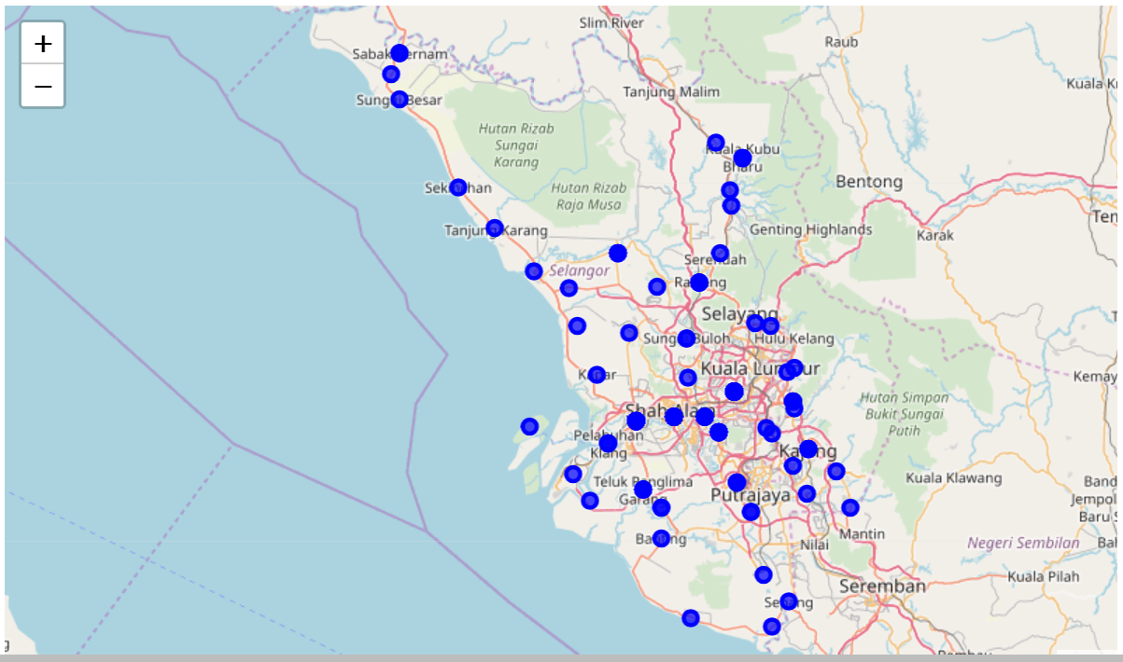
Result
Map of Selangor, Malaysia with all area been mapped on it;

Slide 8
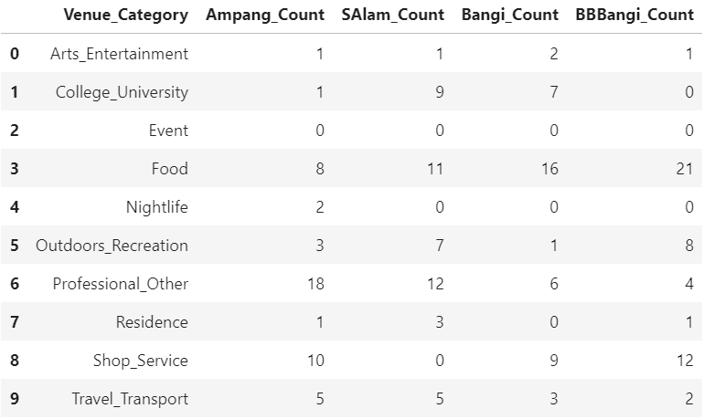
Result
Comparing the venues categories count for Ampang, Shah Alam, Bangi and Bandar Baru Bangi;

Slide 9
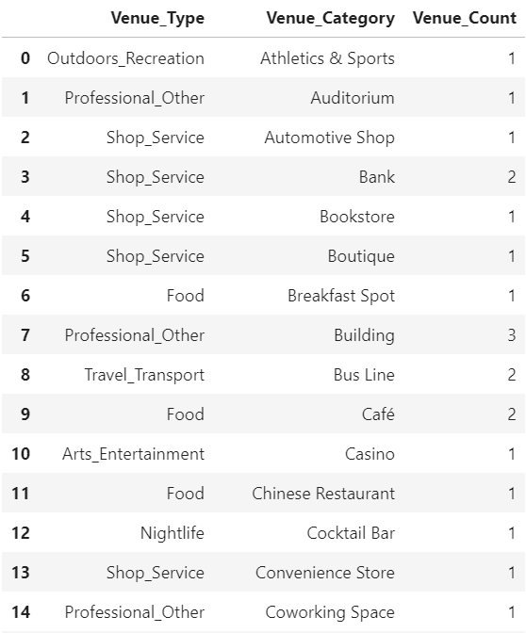
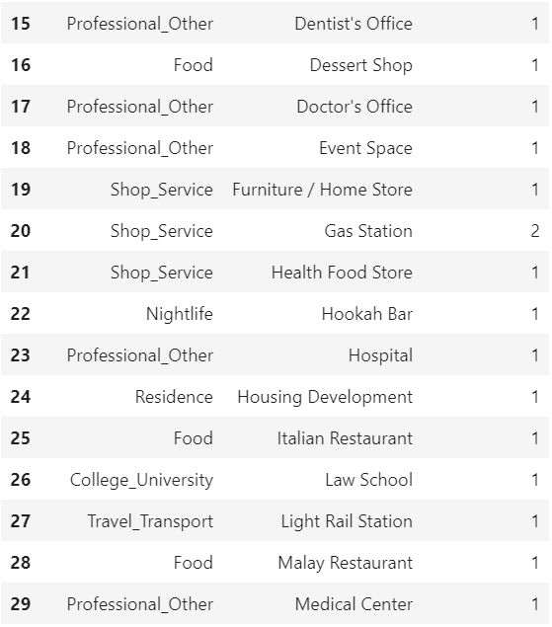
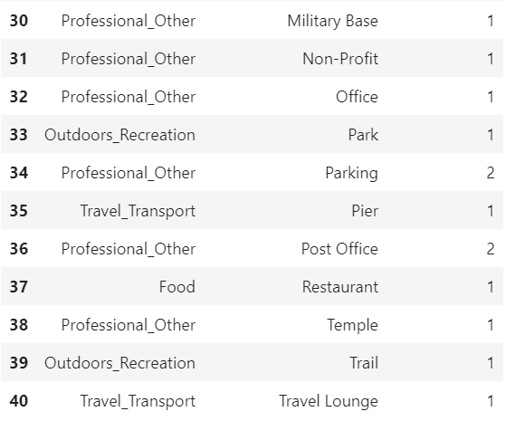
Result
Detailed data on venues in Ampang;

Slide 10
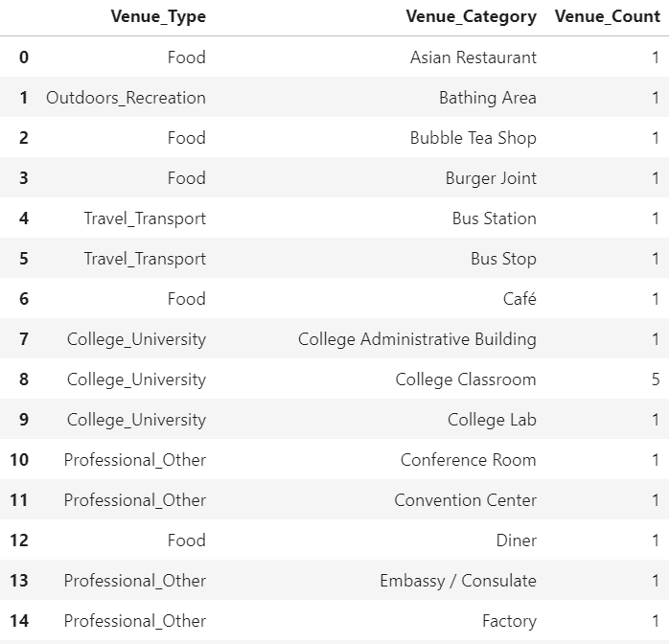
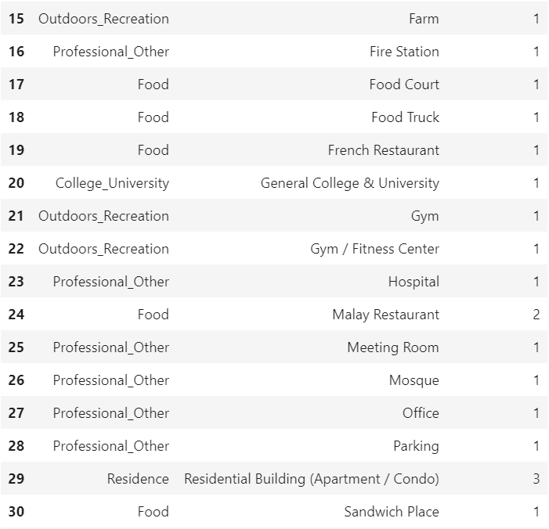
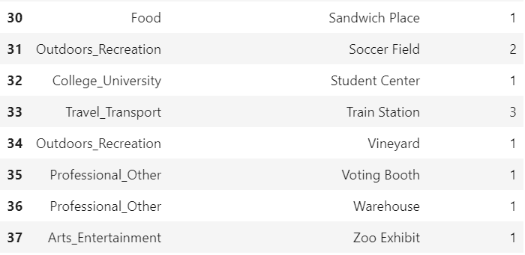
Result
Detailed data on venues in Shah Alam;

Slide 11
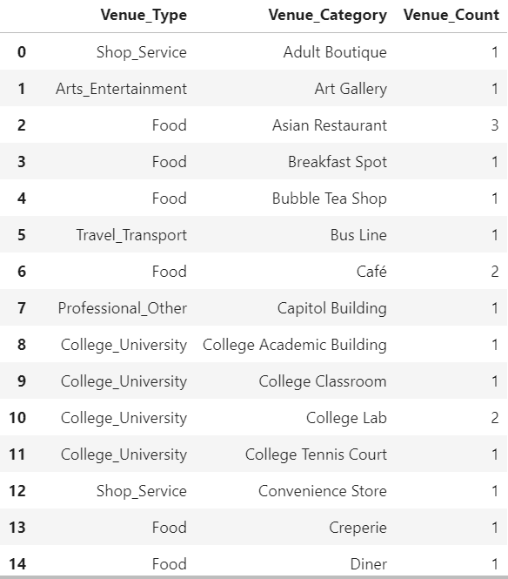
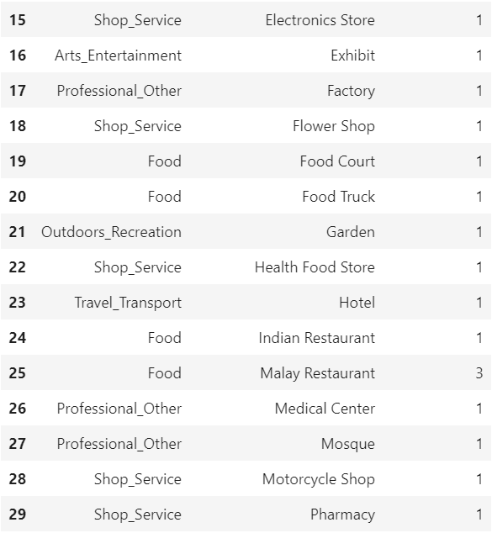
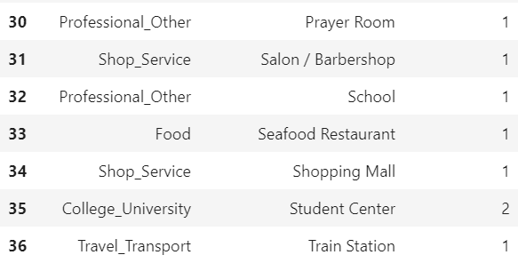
Result
Detailed data on venues in Bangi;

Slide 12
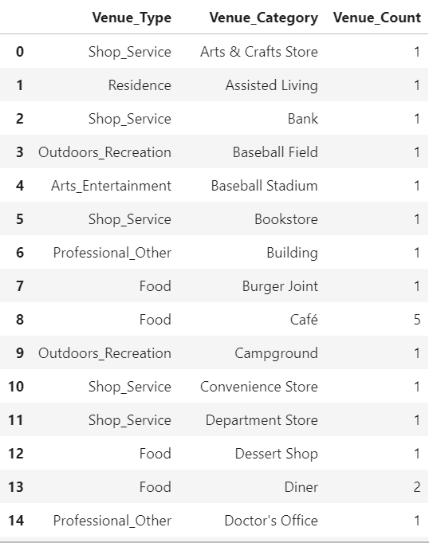
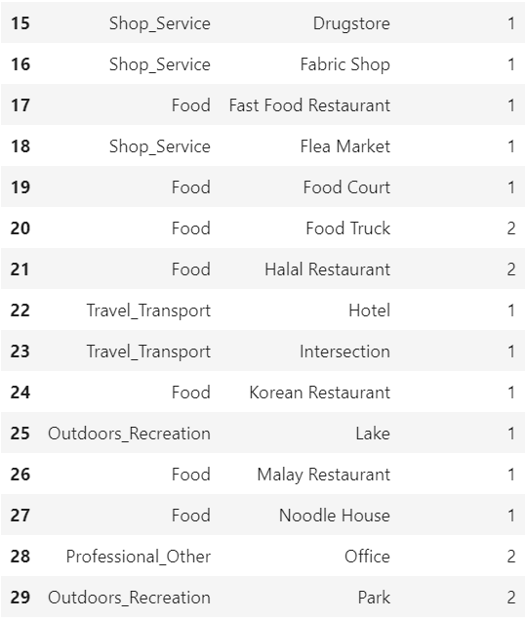
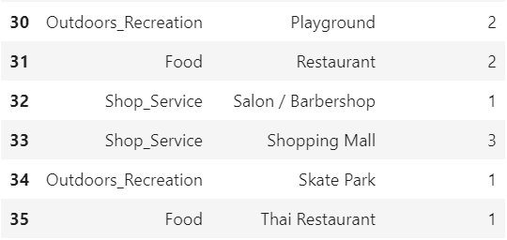
Result
Detailed data on venues in Bandar Baru Bangi;

Slide 13
Discussion
We can concluded the following
Ampang is suitable for the need of Case Study A
He like parties (assuming night time party) and entertainment
Provide many work places and near with many travel terminal point for easy way to travel around
Shah Alam and Bangi is suitable for Case Study B
Many schools for the young children and work places for the the adults
Eldest also can attend the nearest college or university and travel back home everyday
Sadly for Case Study C, none of this 4 areas is suitable for their needs
Shah Alam can provide a better places since it have hospital and based on the maps, is actually quite large area compare to another areas

Slide 14
Conclusion
Data science have proven that it can be use as tools for everyday uses especially in field that required a huge database of latitude and longitude.

